Slide 1
Are You Ready?
Using the TORONTO2015 Games as catalyst for advancing inclusive tourism
December 2, 2014

Slide 2
Background
The TORONTO 2015 Accessibility Advisory Council (see Appendix for membership list) has been meeting since April 2013 to:
Provide advice and direction to TO2015 (i.e. volunteer journey, website improvements, transportation planning etc.)
Developing a legacy initiative that builds accessibility awareness and has a life beyond 2015
Their initiative, the Are You Ready 4 Step Challenge builds on the concept used in the Parapan ‘sizzle’ video and encourages businesses to get ready to be great, inclusive hosts for the Games

Slide 3
Overview of the ‘Are You Ready?’ Campaign
In preparation for the TORONTO 2015 Pan Am/Parapan Am Games, athletes are training hard now so they can deliver their best-ever performance.
Likewise, as a host community, we need to prepare to be the best hosts we can be.
The “Are You Ready?”(AYR) Campaign challenges tourism-related businesses to make four accessibility improvements so that they can be great – inclusive - hosts for the 2015 Pan Am/Parapan Am Games.
The campaign’s recognition program not only rewards the participants but also builds a legacy of public accessibility awareness and the groundwork for larger movements in the inclusive tourism space.

Slide 4
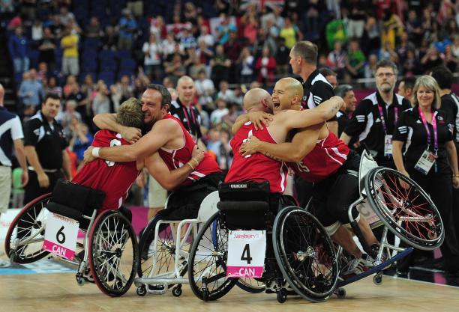
The impact of the AYR Campaign
Picture it…the Canadian Wheelchair Basketball team wins its gold medal match!
They want to go to a restaurant to celebrate.
One result of the AYR campaign is that the team will have access to a database of businesses they and their families can patronize.

Slide 5
The impact of the AYR Campaign cont’d
TORONTO 2015 client groups (athletes, spectators, press etc.,) will benefit from the database of accessible businesses which will be in the Planat tool and linked to tourism portals
Tourism organizations will benefit from being able to link to the accessibility profiles, business complete as part of the challenge
Opportunity to showcase expertise and work of: Accessibility Directorate, Excellence Canada, Inclusive Research Design Centre, Quadrangle
Legacy of resources regarding inclusive tourism and accessible improvements

Slide 6
Program Components
It begins with a challenge: Get ready to welcome the world to TORONTO in 2015!
Visit the Planat website to complete your business’ self-assessment
Attend the Are You Ready Conference and learn about how you can make low-cost, simple improvements to increase your accessibility
Take the challenge; Make the improvements as required
Amend your Planat profile to reflect your improvements
Post your “I Heart Parapan” sticker in your store window

Slide 7
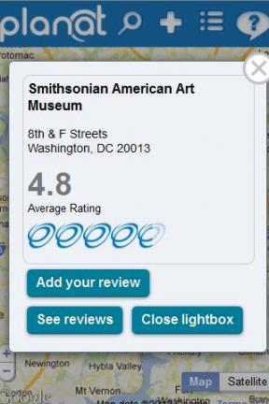

Recognition
In addition to being listed on the Planat tool, challenge participants will also be profiled on:
TORONTO2015 tourism portal
Municipal and provincial tourism portals

Slide 8
Are You Ready Conference is…
A one-day event with the following components:
  Overview of Inclusive Tourism and ROI
  Workshops and demonstrations on each of the 4 steps
  Building a movement: Reception for businesses and AAC

Slide 9
Sample Conference Program
Time | Program component | Details | Potential Lead
10am | Welcome remarks | 10 minutes | TO2015
10:15am | Overview of inclusive tourism | 30 minute presentation; 10 minute Q&A | Lorin, Dave
11am | Real-life example | 30 minute presentation; 10 minute Q&A | Role model business
11:45am | Break & get lunch | 10 minutes
12:15pm | Accessibility at your fingertips | 45 minute panel | Planat, Tourism Toronto, Ontario Tour
1pm | Creating a clear path of travel | 30 minutes | Amy
1:40pm | No-step entrance | 30 minutes | Luke
2:10pm | AODA Customer Service Standard | 30 minutes | ADO
2:40 | Accessible documents and communications | 30 minutes | Jutta/Jan
3:00pm | Real-life example | 30 minute presentation; 10 minute Q&A | Role model business
3:30pm | Closing remarks | 10 minutes | Rt. Hon. David Onley
4pm | Building a movement: Reception for businesses and AAC | 90 minutes | TO2015, AAC, sponsors

Slide 10
Are You Ready?
The Four Step Challenge Steps:
Clear path of travel
No-step entrance
Demonstrate compliance to AODA Customer Service Standard
Accessible documents and communications (website, printed material etc.)
©L. MacDonald & D. Segal, 2014

Slide 11
Step 1: Clear Path to Travel
Challenge objective:
Ensure pathways, sidewalks are clear for people who are: using mobility or other assistive devices; using strollers etc.
30 minute workshop:
The workshop would include tips on how to create a clear path of travel; demonstrate ‘do’s’ and ‘don’ts’; provide a ‘take-away’ with examples

Slide 12
Step 2: No-Step Entrance
Challenge objective:
Ensure entrance to retail outlet has a ramp, power-door operator and no steps
30 minute workshop:
Educate on the importance of no-step entrances; provide overview of the work of Stop Gap; provide information on other tools for no-step entrances

Slide 13
Step 3: AODA Customer Service Compliance
Challenge objective:
Demonstrate compliance to the Customer Service Standard of the Accessibility of Ontarians Disability Act
30 minute workshop:
Provide overview of the AODA and the longer-term plans for a ‘barrier-free’ Ontario.
Demonstrate the various ways business can demonstrate compliance
Outcome: Business are able to declare that they are compliant

Slide 14
Step 4: Accessible Communications
Challenge objective:
Demonstrate that tools used to communicate with public are accessible (i.e. menus, promotional material, website etc.)
30 minute workshop:
Provide direction and resources on developing accessible communications (pdf, websites, etc.)
Outcome: businesses leave equipped to make changes to their communications processes

Slide 15
  Building a movement:
  Reception for businesses and AAC
Invite all TO2015 sponsors and partners to hear more about what can be done post-Games in the area of inclusive tourism
More details to expand

Slide 16
Expanding the AYR Reach
Large conference to be hosted in Whitby at the Abilities Centre
Host 2 abbreviated (half-day) conferences in Hamilton and Toronto
Videotape all footage and upload to TORONTO2015.ORG as resources for businesses who could not attend in person

Slide 17
Next Steps
Confirm four-steps
Prepare toolkit for challenge participants to include:
  Information on Path of Travel specifications
  No-step entrance information (re: Stop Gap, power entrance costs)
  Information on AODA customer service standard
  Information on Accessible communications
  FAQs on Inclusive Tourism
Outreach to businesses
  Toronto Association of Business Improvement Areas
  Others; working with TO2015 Tourism Community of Practice
Outreach to appropriate government agencies and ministries
Confirm recognition
  Confirm approach and use of Heart Parapan
  Planat™ – uploading data
©L. MacDonald & D. Segal, 2014

Slide 18
High-level Workplan
Action | Lead | Deadline | Status | Notes
Confirm four-steps | TO2015 | November 10, 2014 | Complete
Confirm conference approach | AAC | November 19, 2014 | Complete
Prepare toolkit for challenge participants | Relevant AAC members with TO2015 support | December 10, 2014
Confirm recognition program | TO2015 | December 10, 2014
Outreach to businesses | Relevant AAC members and TO2015 | January 5, 2015
Proposed conference date |  | February 20
©L. MacDonald & D. Segal, 2014

Slide 19
Appendices

Slide 20
TORONTO 2015 Accessibility Advisory Council Members
Alfred | Spencer | Director, Outreach and Strategic Initiatives Branch | Accessibility Directorate of Ontario
Amy | Pothier | Accessibility Specialist | Quadrangle Architects Ltd.
Andrea | Rae | Inquiries Generalist | Centre for Independent Living in Toronto (C.I.L.T.) Inc
Anne | Collinson | Senior Program Advisor | Accessibility Directorate of Ontario
Archie | Allison | Director, Access and Awareness | Variety Village
Brian | Mclean | Interim Executive Director | Parasport Ontario
Christie* | Aylan-Parker | Sr. Program Advisor | Legacy Programs Branch, Partner Engagement and Legacy Division, Pan/Parapan American Games Secretariat
Cynthia | Berringer | Para-athlete; advocate | TO2015 Youth Advisory Council
Eric | Cartlidge | Past Executive Director | ParaSport Ontario
Erika | Schmutz | Paralympian (Wheelchair Rugby) | TO2015 Athlete Advisory Council
Gaetan | Tardif | President, Canadian Paralympic Committee; Medical Program Director - Rehab & Post-Acute Care | University Health Network
Jan | Richards | Project Manager, Inclusive Design Research Centre | OCAD University
Jenny | Blome | Product Manager, Planat | Rick Hansen Foundation
Jesse | Klimitz | Accessibility Specialist, Intern Architect | Quadrangle Architects Ltd.
Jill | LeClair | Professor | Humber College
Joe | Henry | Associate Dean of Student Success | Sheridan College
Jutta | Treviranus | Faculty, OCAD University; Director, Inclusive Design Research Centre | OCAD University
Kathy | McLachlan | Manager, Strategic Initiatives Unit | Accessibility Directorate of Ontario
Leo | Plue | Executive Director | Abilities Centre
Luke | Anderson | Founder | Stop Gap
Marcia | Rioux | Professor, School Health Policy & Management (Graduate Programs CDS and Health Equity) | York University
Michael | Dawthorne | Program Manager for Ontario Interpreting Services and Communication Access Real-Time Captioning | The Canadian Hearing Society
*observer

Slide 21
Pre-conference
Following their registration and in advance of the event, registrants will be asked to go to Planat™ and assess themselves. They will bring the results of their assessment to the conference in the hopes that they can find the information they need to “Take the Challenge”

Slide 22
Primary changes to the previous proposals
Focus energy on information event
Host a post-event reception for sponsors to meet with AAC members to discuss future programs
Move from 5-steps to 4-steps
Program components led by TO2015 staff; AAC to provide continued advice
AAC to identify volunteers to support particular components
Planat™ use for uploading accessible venue data

